Slide 1
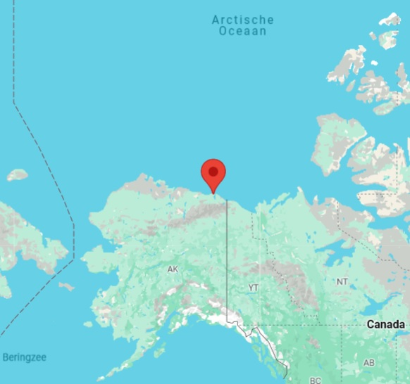
Kaktovik numbers
Frits Spijkers 22-08-2024
Let’s try something entirely different.

Slide 2
Kaktovik numbers
Kaktovik (Qaaktugvik in Iñupiag – the language of the Inuït) is a small city in northern Alaska. Most of its inhabitants were of Inuït origin. • The inuït numbersystem has base 20. • In the 20th century there was no written numbersystem in Iñupiaq.
In 1994 the middle school in Kaktovik had 9 students. They together invented a written number system.

Slide 3
The Kaktovik numerals Criteria:
Visual simplicity: The symbols should be "easy to remember.“
Iconicity: There should be a "clear relationship between the symbols and their meanings.“
Efficiency: It should be "easy to write" the symbols, and they should be able to be "written quickly" without lifting the pencil from the paper.
The students came up with five qualities that an ideal system should have.

Slide 4
The Kaktovik numerals Criteria:
Distinctiveness: They should "look very different from Arabic numerals," so there would not be any confusion between notation in the two systems..
Aesthetics: They should be pleasing to look at.
The students came up with five qualities that an ideal system should have.

Slide 5
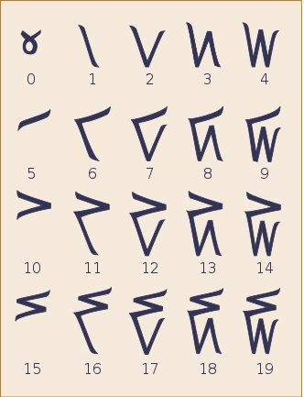
This is what they made
Their sign for “zero” is two crossed arms.
All the other numerals consist of vertical and/or horizontal strokes.
20 symbols (numbers) in groups of 5. Every horizontal stroke equals 5 vertical strokes.

Slide 6
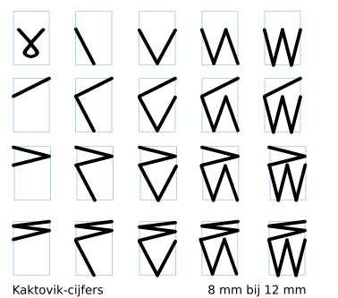
This is what I’ve made
I wanted all symbols fitting into the same rectangle.
Those rectangles are only used to make pictures.

Slide 7
Let’s make numbers To make Kaktovik numbers you need to think in base 20:
$32=20+12$, so it becomes
$613=1∙{20}^{2}+10∙20+13$,
so it becomes
$860=2∙{20}^{2}+3∙20+0$,
so it becomes
$5923=14∙{20}^{2}+16∙20+3$,
so it becomes
When I use Indian/arabicdigits, the numbers are always in the decimal system.
Use the powers of 20 to convert.
Different colors for different positions

Slide 8
Practice Well, now you have a go at:
$432$
$6013$
$8600$
When I use Indian/arabicdigits, the numbers are always in the decimal system.
Use the powers of 20 to convert.

Slide 9
Practice And the answers are:
$432=1∙{20}^{2}+1∙20+12$, so it becomes
$6013=15∙{20}^{2}+0∙20+13$, so it becomes
$8600=1∙{20}^{3}+1∙{20}^{2}+10∙20+0$, so it becomes
When I use Indian/arabicdigits, the numbers are always in the decimal system.
Use the powers of 20 to convert.

Slide 10
Arithmetics (part 1) And now you are eager to do some basic arithmetics with Kaktovik numbers.
Well, it is very visual work, addition and subtraction is simply adding or removing strokes. We’re now going to have a look at:
Addition: $632+189$
Subtraction: $632−189$
Of course you can always check your answers by converting to the decimal system.

Slide 11
Addition (easy) First have a look at these easy examples:
$4+2=6$ becomes
$18+7=25$ becomes
Adding is simply putting all strokes together and then looking what you’ve got.
The middle part is meant to be done inside your head??

Slide 12
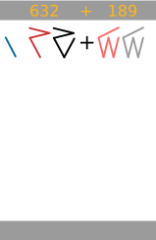
Addition (example)
First, check the conver-sion to Kaktovik-numbers.

Slide 13
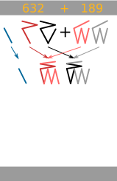
Addition (example)
Add all symbols on the same positions.

Slide 14
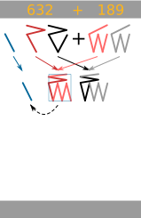
Addition (example)
In de 2nd position (the 20’s) there is a 20 to be found, so that has to go to de 400’s.

Slide 15
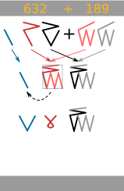
Addition (example)
Now on the 2nd position (the 20’s) the remain-der is 0.

Slide 16
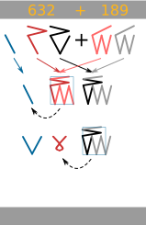
Addition (example)
On the first position (the units) there is a 20 to be found. That goes to the 20’s position.

Slide 17
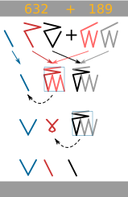
Addition (example)
So we get a 1 on the 20’s position.

Slide 18
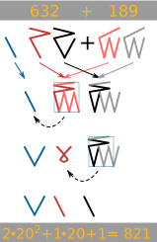
Addition (example)
And (if you’re not an Inuït who is using this system everyday) you check your answer in the decimal system.

Slide 19
Practice (addition)
$512+346$
$1024+299$
And check your answer in the decimal system).

Slide 20
Subtraction (easy) First have a look at these easy examples:
$6−2=4$ becomes
$25−7=18$ becomes
Subtraction is removing strokes and then looking what you’ve got.
But first you have to take care that there is something to remove.
The middle part is meant to be done inside your head??

Slide 21
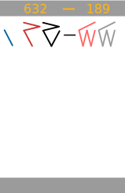
Subtraction (example)
First, check the conver-sion to Kaktovik-numbers.

Slide 22
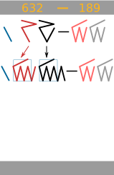
Subtraction (example)
Write the first two positions from the first number in such a way that you can subtract the second number.

Slide 23
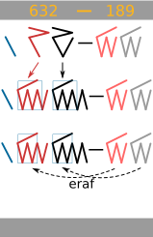
Subtraction (example)
Recognize the elements you can remove when subtracting the second number from the first.

Slide 24
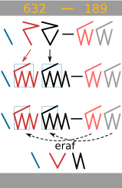
Subtraction (example)
Recognize the elements you can remove when subtracting the second number from the first.
remove

Slide 25
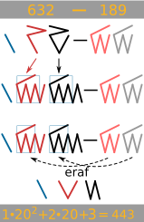
Subtraction (example)
Again, check your answer by using the decimal notation.
remove

Slide 26
Practice (subtraction)
$512−346$
$1024−299$
And check your answer in the decimal system).

Slide 27
Arithmetics (part 2) I hope you’re not bored by now, but arithmetics also means multiplication and division. We’re now going to have a look at:
Multiplication: $512∙58$
Division: $29696/58$
Of course you can always check your answers by converting to the decimal system.

Slide 28
Multiplication (basics) Multiplication is based on a multiplicationtable. First I’ll show you how this table is made. For instance:
$4∙16=64$
$12∙19=228$
The multiplication-table contains all possible multiplications of the 20 basic Kaktovik numerals.

Slide 29
Multiplication (basics) In this way you can multiply all 20 basic numerals en get a complete multiplicationtable.
I’ll give you a copy of that table.
Then we can do some serious multiplication.
The multiplication-table contains all possible multiplications of the 20 basic Kaktovik numerals.

Slide 30
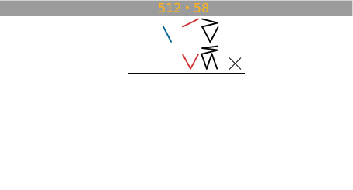
Multiplication (example)
First check the conver-sion.

Slide 31
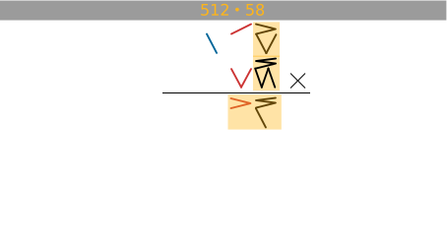
Multiplication (example)
First multiply the units of the first number with the units of the second number. Use your multipli-cationtable.

Slide 32
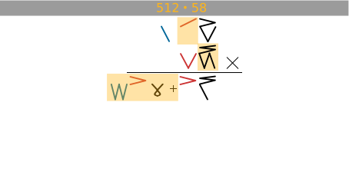
Multiplication (example)
Then multiply the 20’s of the first number with the units of the second number. Mind the zero for the units of this answer.

Slide 33
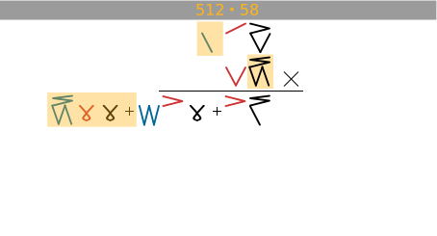
Multiplication (example)
Then multiply the 400’s of the first number with the units of the second number. Now you add zero’s for the units and the 20’s.

Slide 34
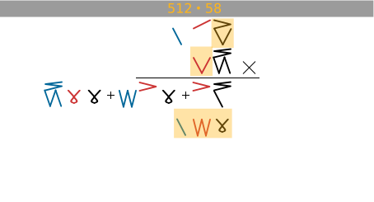
Multiplication (example)
Then multiply the units of the first number with the 20’s of the second number. Now you also add a zero for the units.

Slide 35
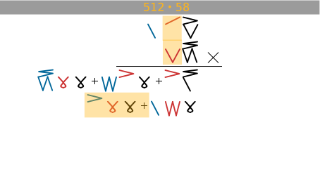
Multiplication (example)
Then multiply the 20’s of the first number with the 20’s of the second number. And add zeros.

Slide 36
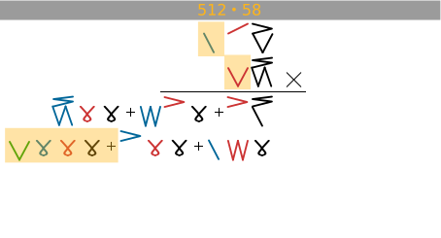
Multiplication (example)
Last multiply the 400’s of the first number with the 20’s of the second number. And add zeros.

Slide 37
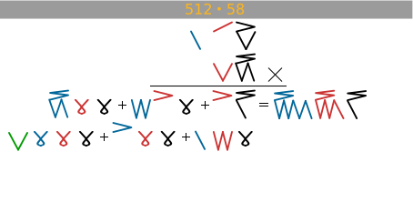
Multiplication (example)
Now you have to add it all.
We start with the upper row.

Slide 38
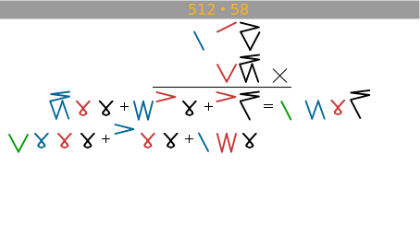
Multiplication (example)
After some rewriting you get the number belonging to the first row.

Slide 39
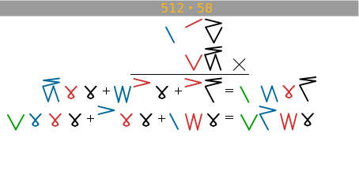
Multiplication (example)
Now we add everything on the second row.
Luckily no rewriting is necessary!

Slide 40
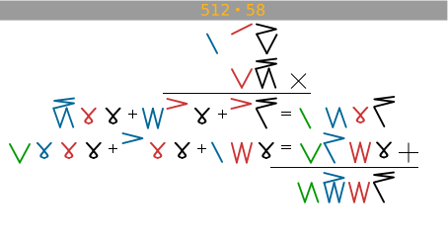
Multiplication (example)
Last we add the results of both rows. And we get an immedi-ate result. Now you only have to check if this really is 29696.

Slide 41
Practice (multiplication)
$113∙25$
$1024∙299$
And check your answer in the decimal system).

Slide 42
Division (basics) Division is nothing more then looking how many times one number fits into another number.
For instance:
$\frac{18}{6}=3$ becomes:
$\frac{19}{9}=2$ with remainder $1$ becomes:
In order to find out how many times a number fits into another number, you have to split the other number into parts that are equal to the first number.

Slide 43
Division (example)
We really don’t have to check the conversion, do we?

Slide 44
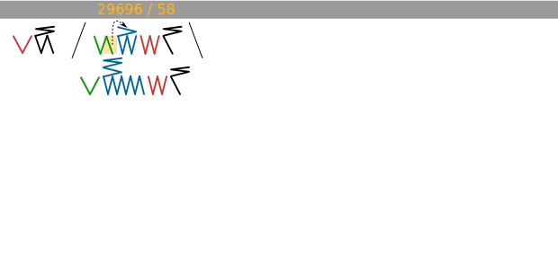
Division (example)
We try to fit the divisor into the dividend by rewriting the dividend to have parts that look like the divisor.

Slide 45
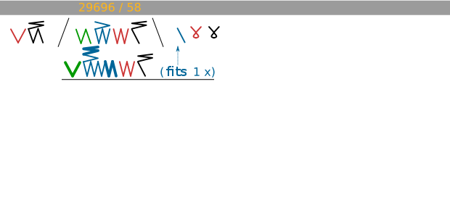
Division (example)
The divisor fits 1 time on the blue position (the 400’s). You can add zeros for the 20’s and the units.

Slide 46
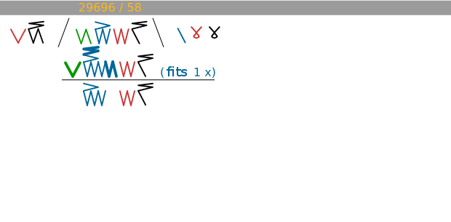
Division (example)
Then by subtraction we’ll find what there is left.

Slide 47
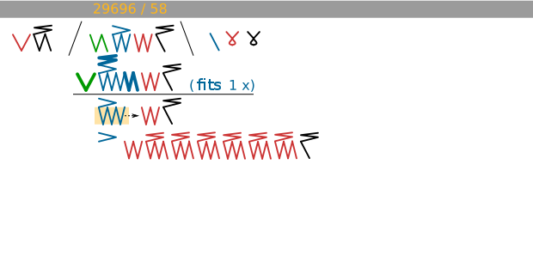
Division (example)
Then again we have to fit our divisor and therefore rewrite what’s left.

Slide 48
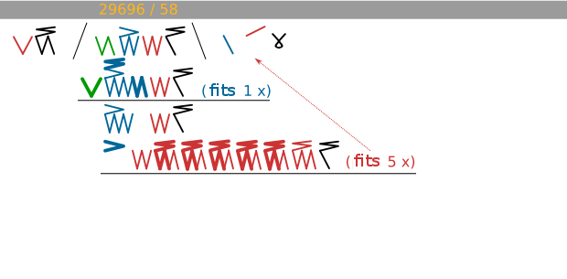
Division (example)
Hopefully you can see that the divisor fits 5 times now.

Slide 49
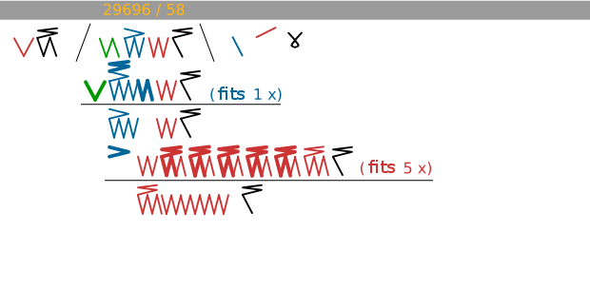
Division (example)
Now you see what’s left when you remove 5 times the divisor.

Slide 50
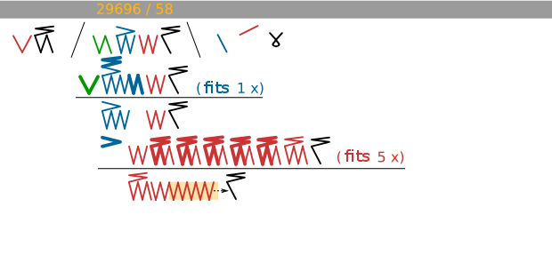
Division (example)
There is some serious rewriting to be done.

Slide 51
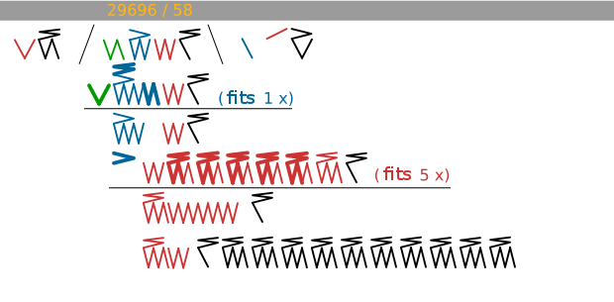
Division (example)
This is a first step.

Slide 52
Division (example)
This is a second step.

Slide 53
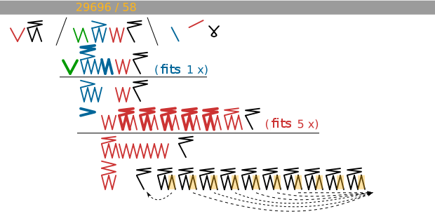
Division (example)
And we need a third step to check the idea that the divisor fits 12 times now.

Slide 54
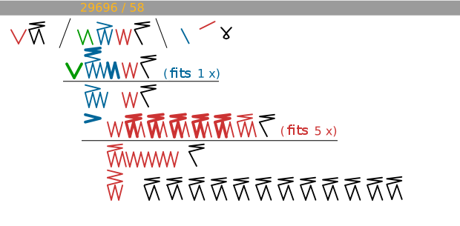
Division (example)
At last we get this result.

Slide 55
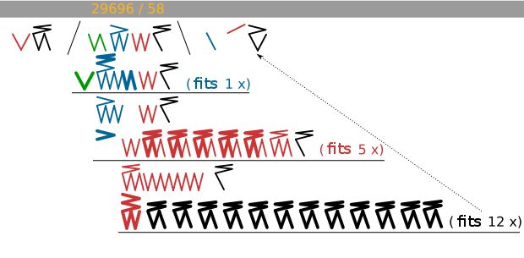
Division (example)
And you see that the divisor fits indeed exactly 12 times.

Slide 56
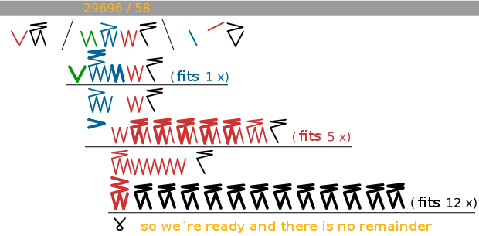
Division (example)
There is nothing left over, so this division has no remainder and it is finished.

Slide 57
Practice (division)
$\frac{2825}{25}$
$\frac{1024}{48}$
And check your answer in the decimal system).

Slide 58
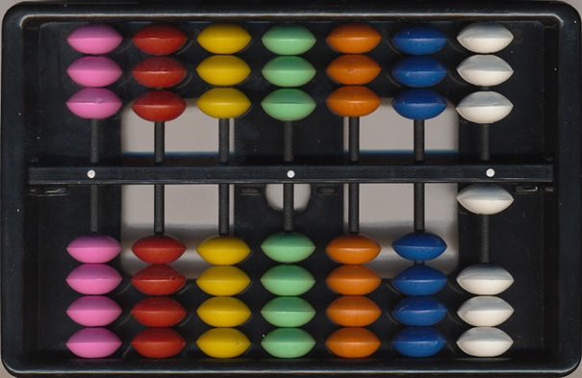
Are there any tools?
Of course you would like to have some tools when calculating with the Kaktovik numbers.
This is all I could find:
Working with large num-bers make calculations with Kaktovik numbers somewhat tricky.

Slide 59
The Kaktovik abacus
The Kaktovik abacus has 7 columns. The units (vertical strokes, max.4) are under the separation bar. The fives (horizontal strokes, max.3) are above the separation bar.
All you have to do is sliding beads toward the separation bar.

Slide 60
Finally?
I hope you enjoyed working with the Kaktovik numbers. Perhaps you would like to experiment more. For instance with numbers smaller then 1, or negative numbers. Then I wish you good luck!
Perhaps you can get a Kaktovik abacus (or make one) and experi-ment with it.

